Slide 1
Steps taken by Indian Government to fight against covid-19
PRESENTATION BY
Atharva Gaikwad
Swaraj Godse
Sujal Dare

Slide 2
Complete India lockdown
When corona virus was spreading all over the world very forcefully and fastly
To prevent India from corona virus Government of india announced complete india lockdown at 23 march 2020
The lockdown was followed till three weeks

Slide 3
Closing of Schools ,Offices ,Transports. etc.
In cities maximum gathering is in schools ,offices and transports like trains , buses etc.
To control this gathering Government has decided to close the schools , offices and transports etc.
And they have also decided to take school classes , office meetings online

Slide 4

23 March 2020 Hestoric lockdown in India

Slide 5
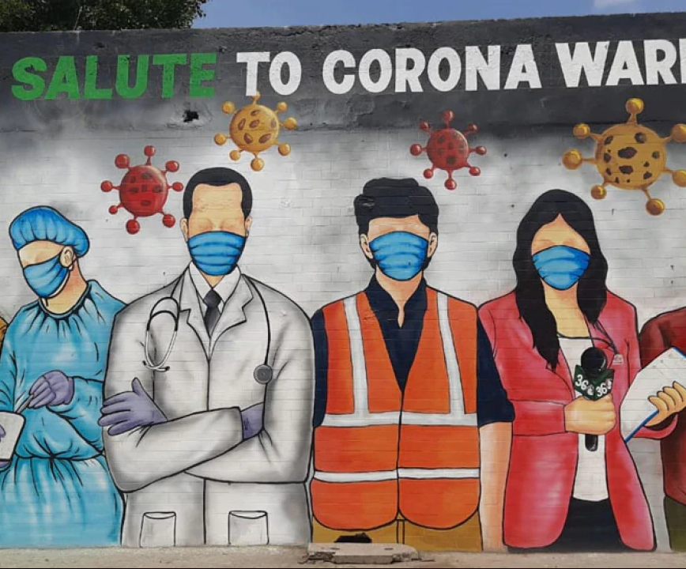
Corona warriors helps us in
Giving updates
Save our lives
Clean our surroundings
Doing survey

Slide 6
Launching of aarogya setu
Aarogya setu is a location based mobile app launched by Government of India to connect health services
This app tells us :
Is there any patient in our surrounding
Have we meet to any infected person
How to stay safe from corona virus…

Slide 7
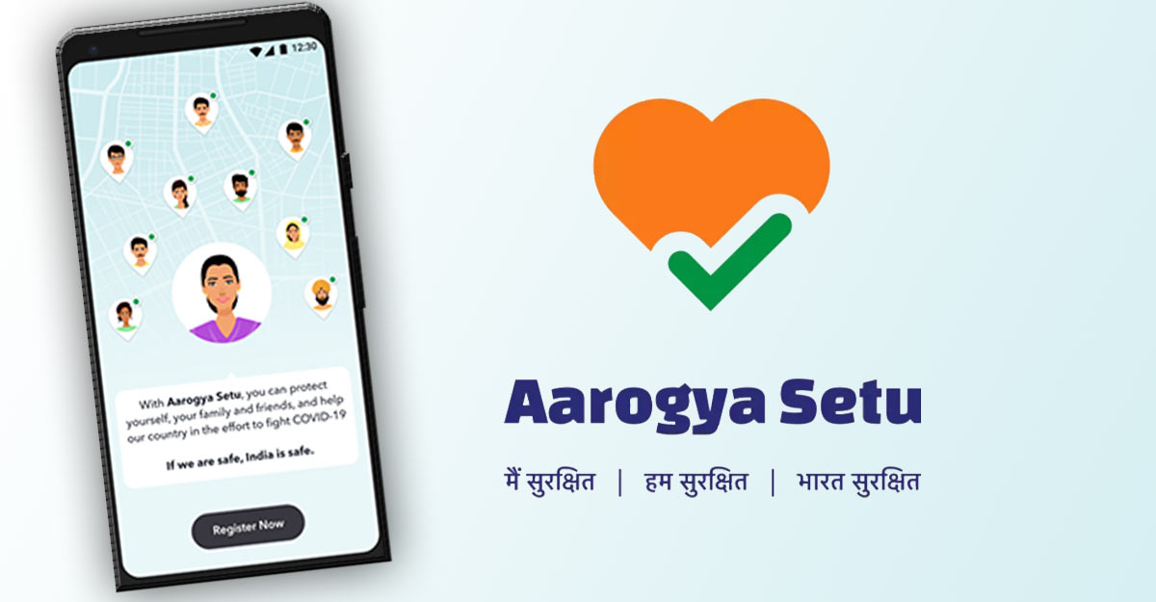
Aarogya Setu

Slide 8
Conversation of Governmental hospital to covid care center
When the covid-19 cases were increasing in India ccc to care the patients infected by corona virus
in this situation Indian Government has decided to convert Governmental hospitals into covid care centers& private hospitals as well

Slide 9
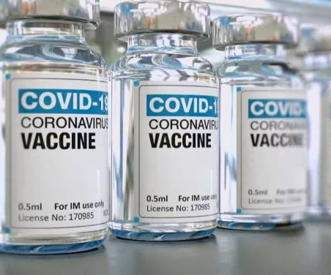
Allow some companies to make vaccines
When the no of cases were increasing of Corona virus Government of India decided to give contract to some companies to make the vaccine on corona virus

Slide 10
Try to open some facilities
When the cases were becoming less our Government has decided to open some facilities
By unlock one
They have also tried to unlock:
Schools/collages
Banks
Offices
etc.

Slide 11
Forced people for wear masks and proper sanitization
When Government open some facilities many people were out of home
For this situation:
Government were saying all the people
For using masks/face covers
And also sanitizers / hand wash

Slide 12


